Slide 1
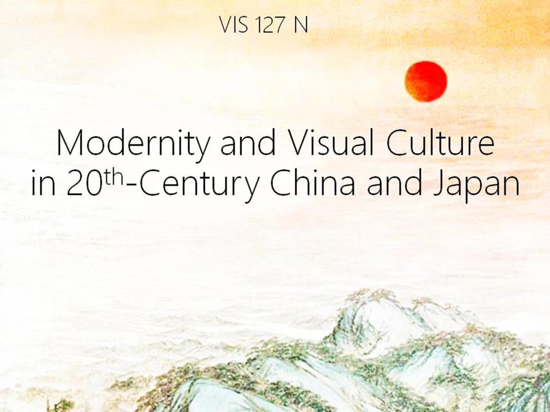

Slide 2
Art in Shanghai
after 1991:
“Chinese Maximalism”

Slide 3
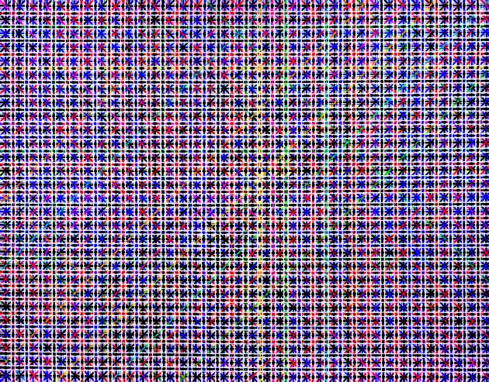
Ding Yi, Appearance of Crosses series,
2002
Ding Yi, Appearance of Crosses series,
Acrylic on tartan, 2002

Slide 5
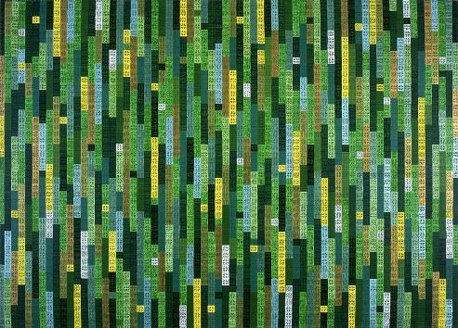
Ding Yi, Appearance of Crosses series,
2002
Ding Yi, Appearance of Crosses series,
acrylic on tartan, 2002

Slide 7
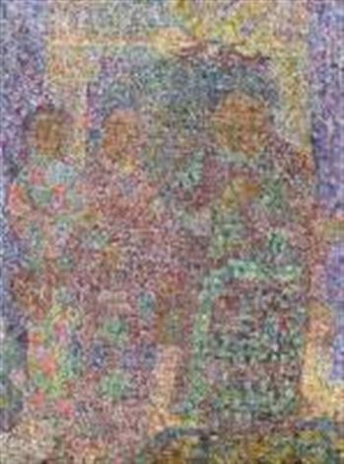
Zhu Xiaohe, One Child Family, 2002
Zhu xiAHE, One Child FILY,
Zhu Xiaohe, One Child Family, 2002

Slide 8
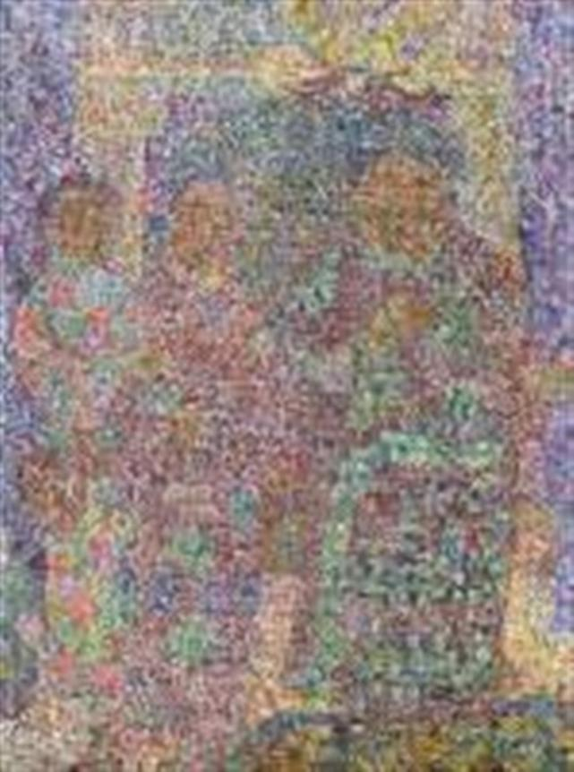

Slide 9
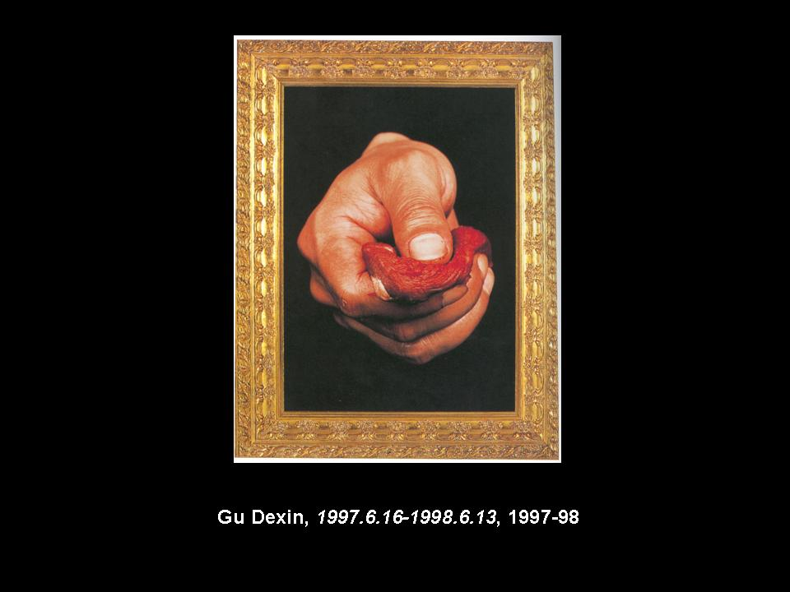

Slide 10
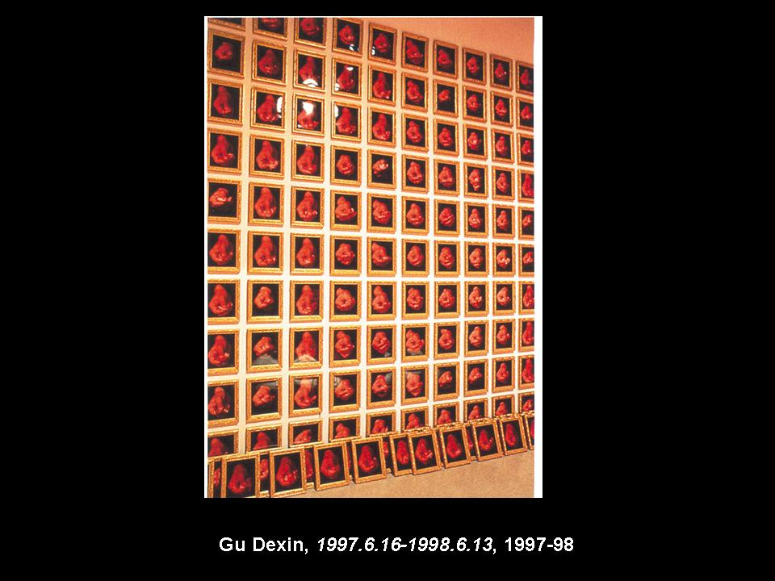

Slide 11
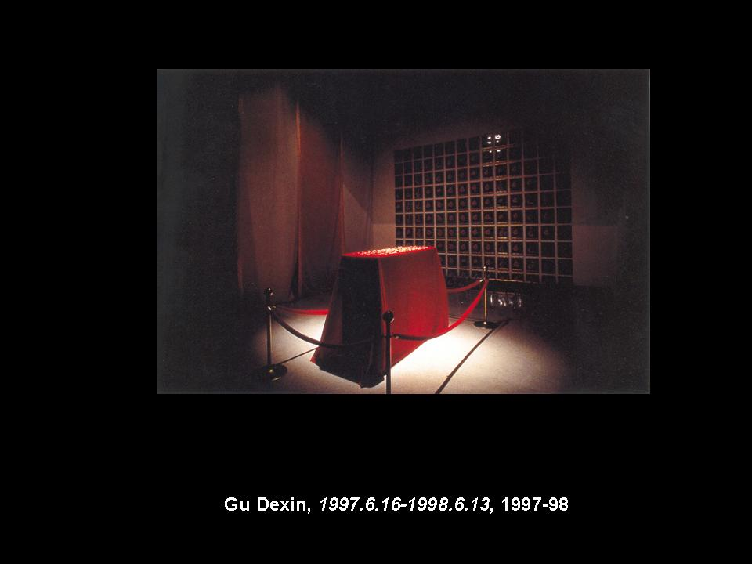

Slide 12
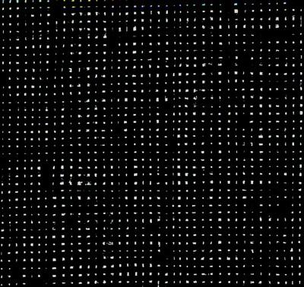
Li Huasheng, February 7, 1991
148 x 146 cm, ink on rice paper

Slide 13


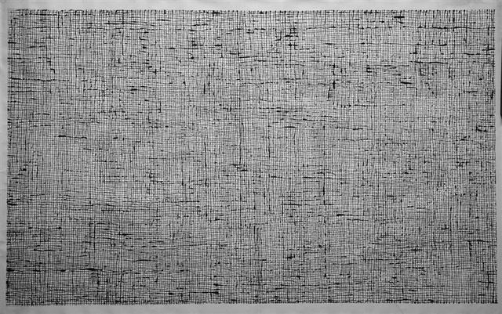
Li Huasheng, February 7, 2001
Ink on rice paper, 70 x 138.5 cm,

Slide 14
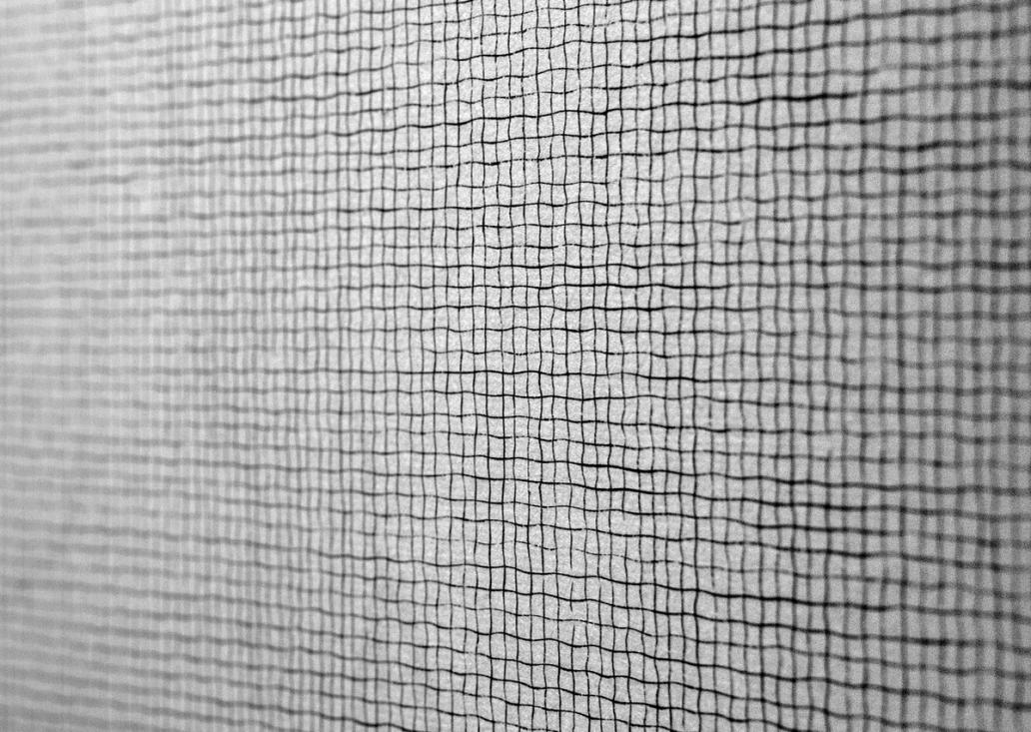
Li Huasheng, 1241,
ink on paper, 70 x 138.5 cm, 2012

Slide 15
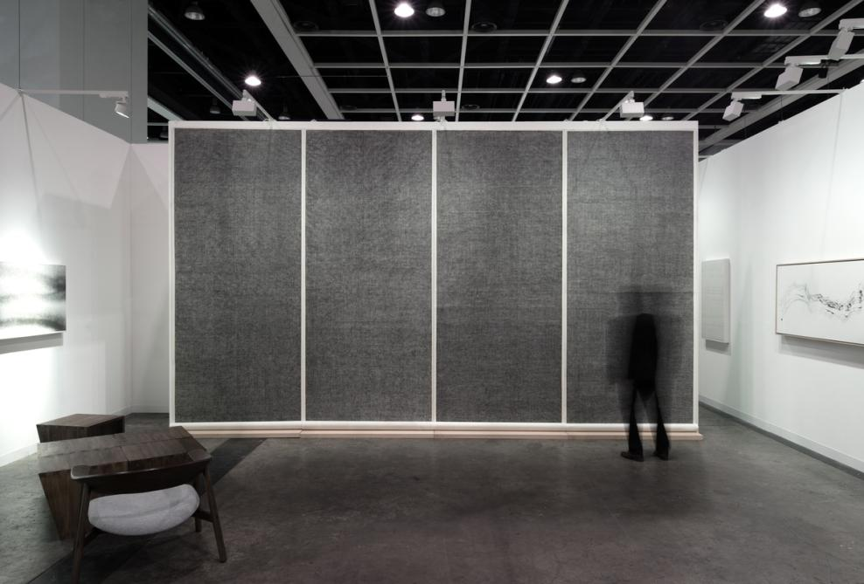
Li Huasheng,
Installation at Art Basel | Hong Kong, 2016

Slide 16
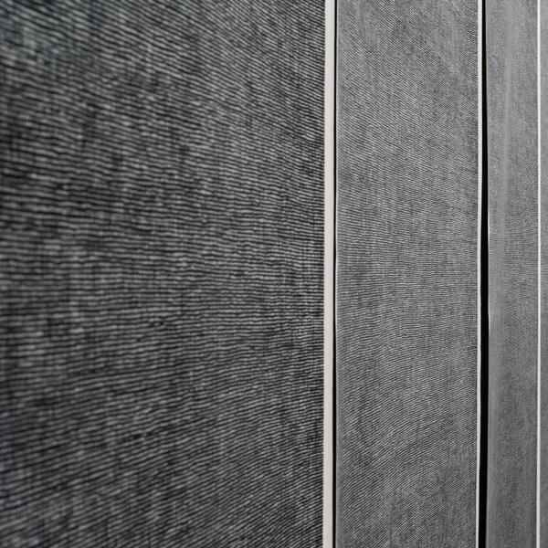

Slide 17
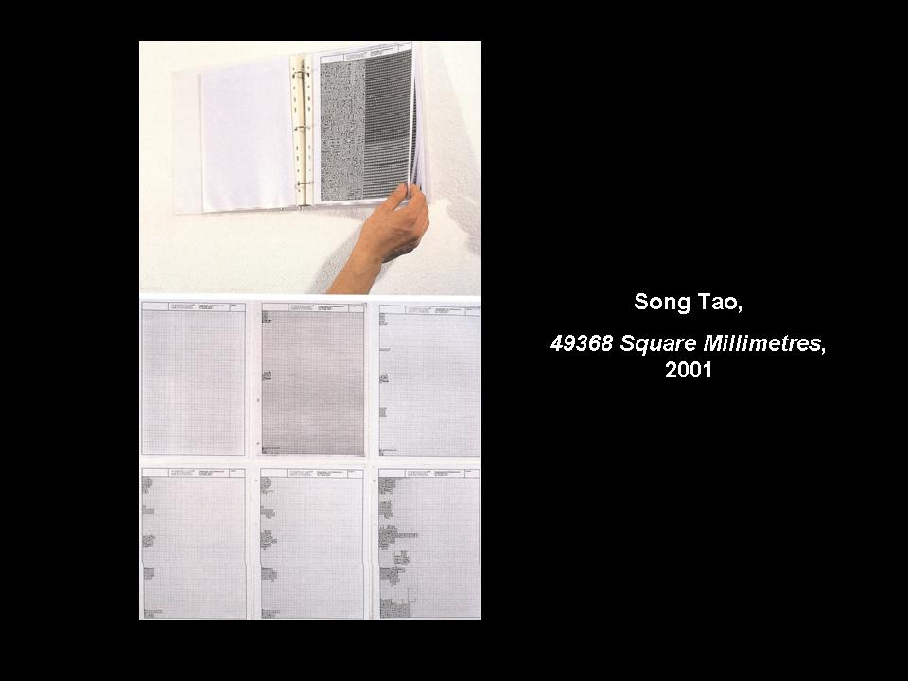

Slide 18
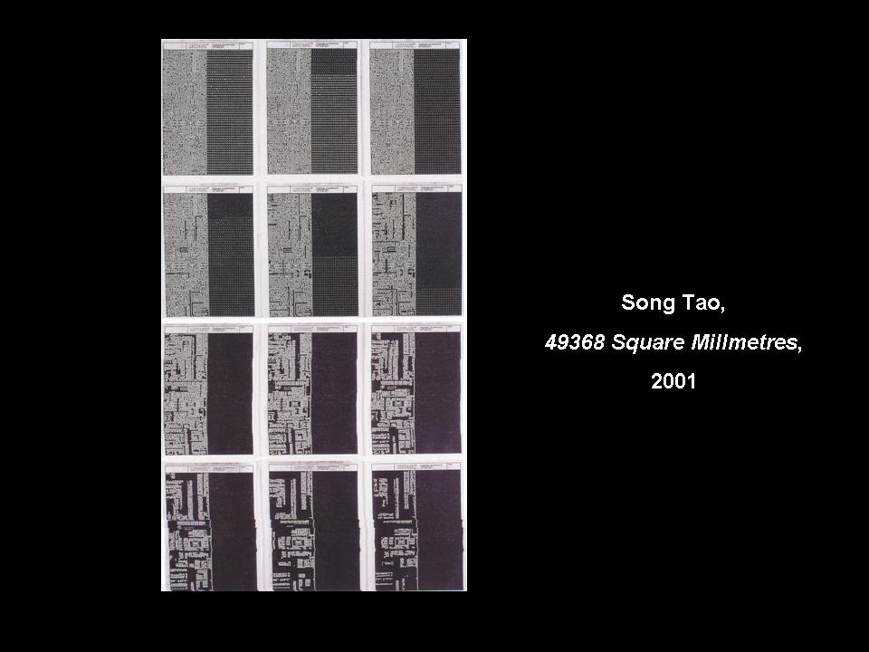

Slide 19
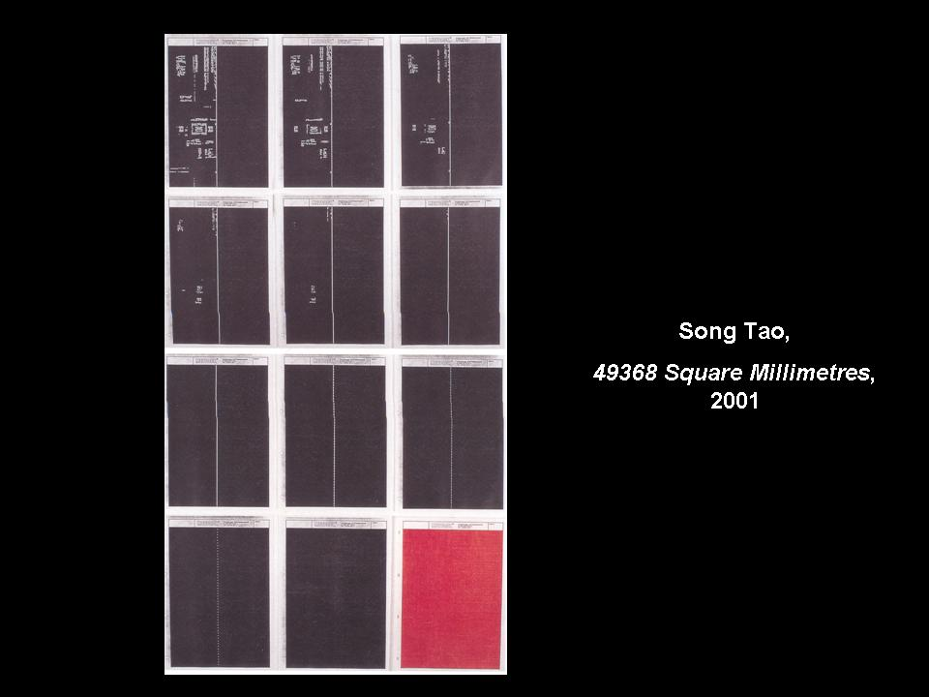

Slide 20
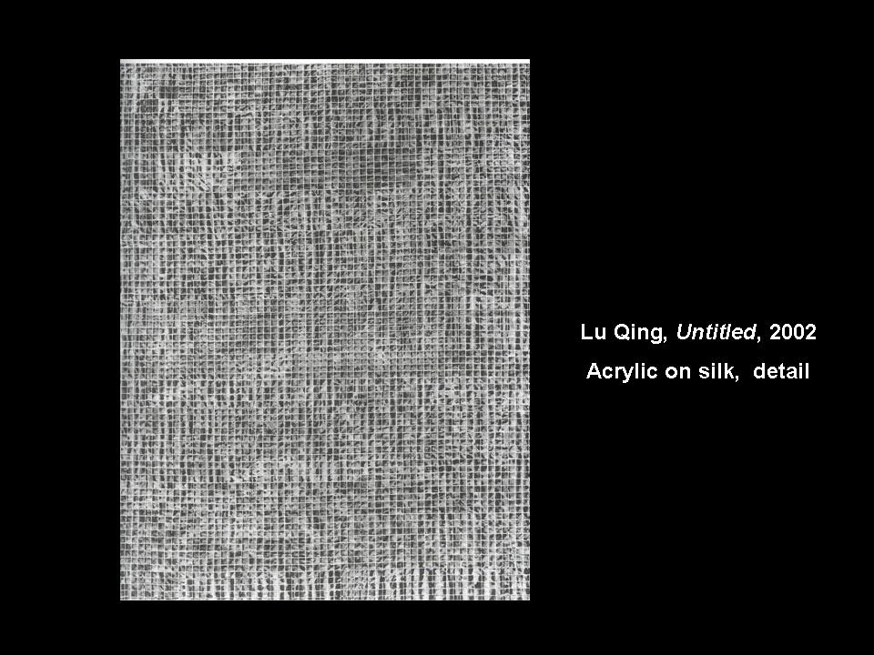

Slide 21
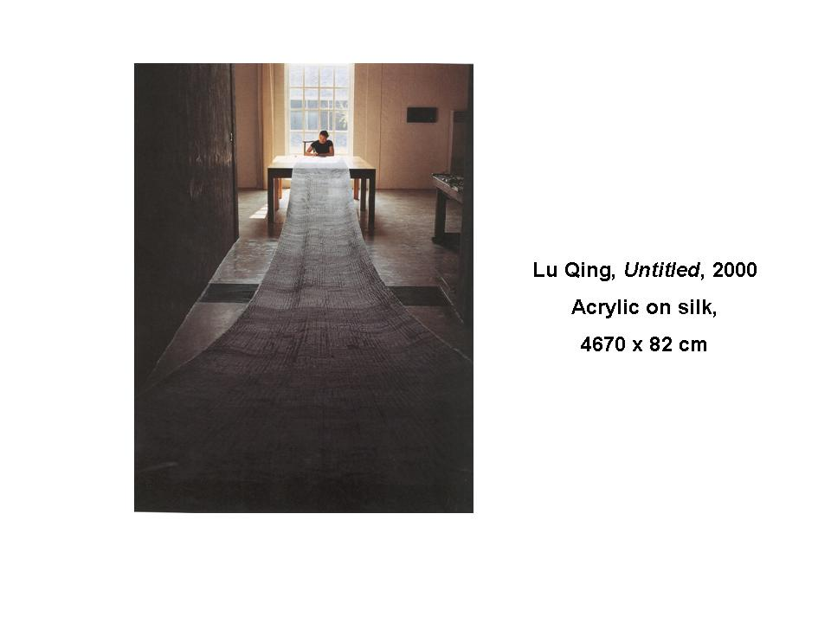

Slide 22
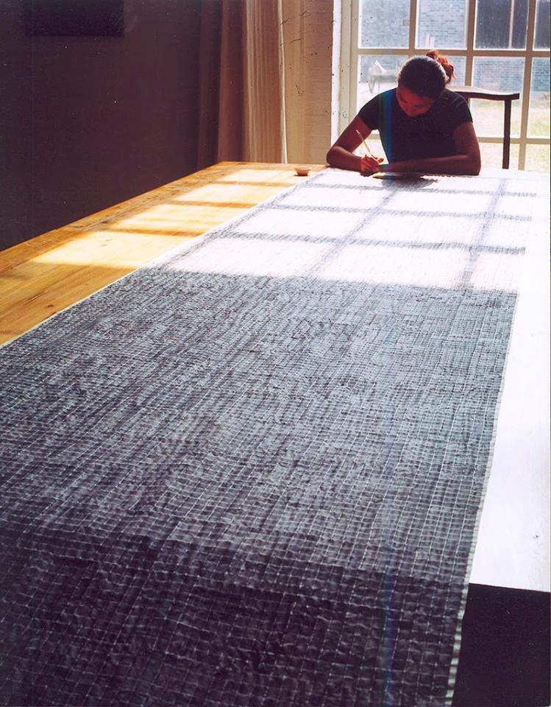

Slide 23
Art in Shanghai
after 1991:
Shanghai Ethnographers

Slide 24
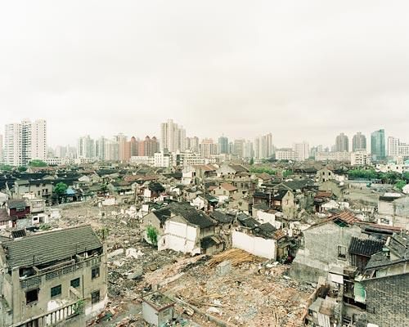

Slide 25
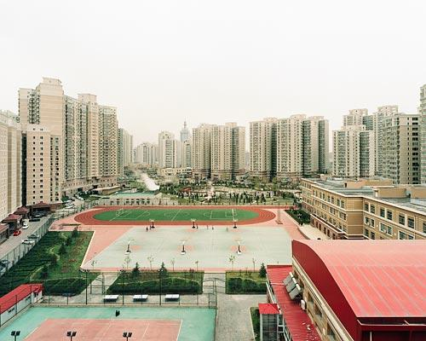

Slide 26
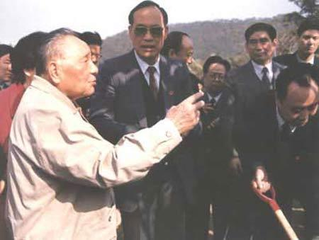
Deng Xiaoping’s South China tour,
1992

Slide 27
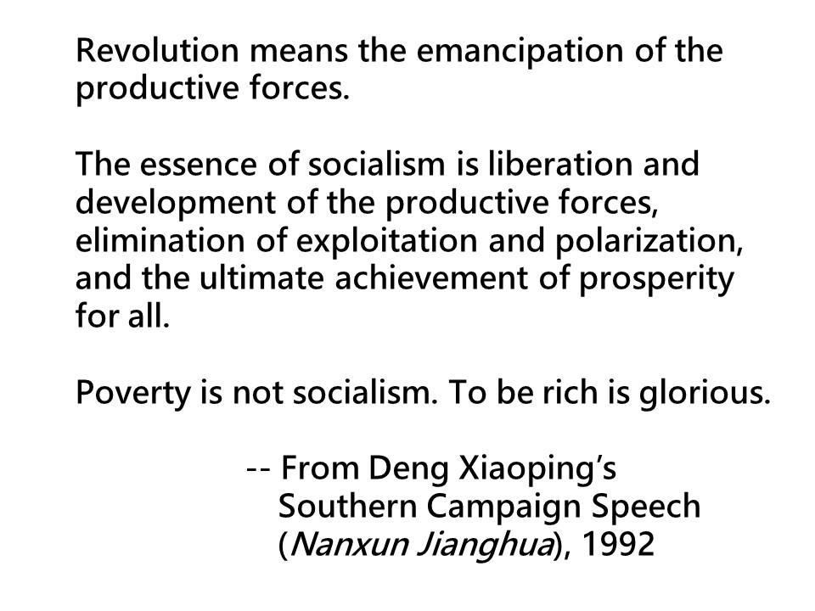

Slide 28
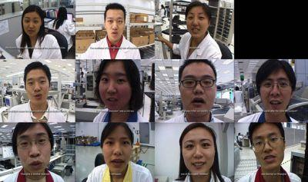
Yang Zhenzhong, Spring Story
video, 2003

Slide 29
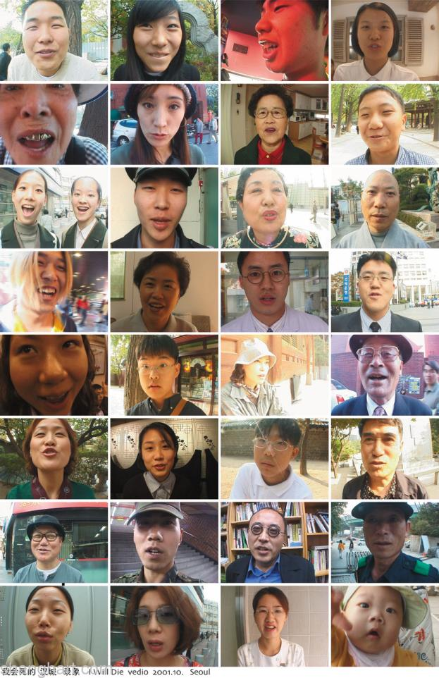
Yang Zhenzhong,
I am going to die,
video, 2007

Slide 30
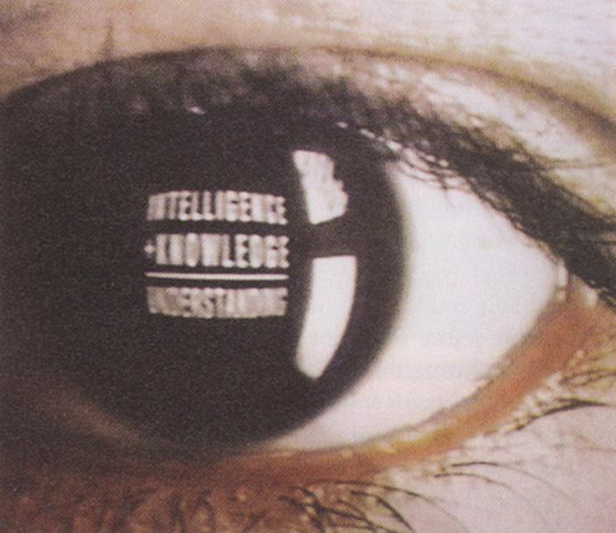
Qian Weikang, Breath/Breath, video, 1996

Slide 31
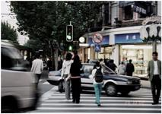
Liang Yue, from Several Dusks, 2003

Slide 32
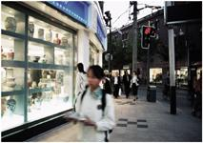
Liang Yue, from Several Dusks, 2003

Slide 33
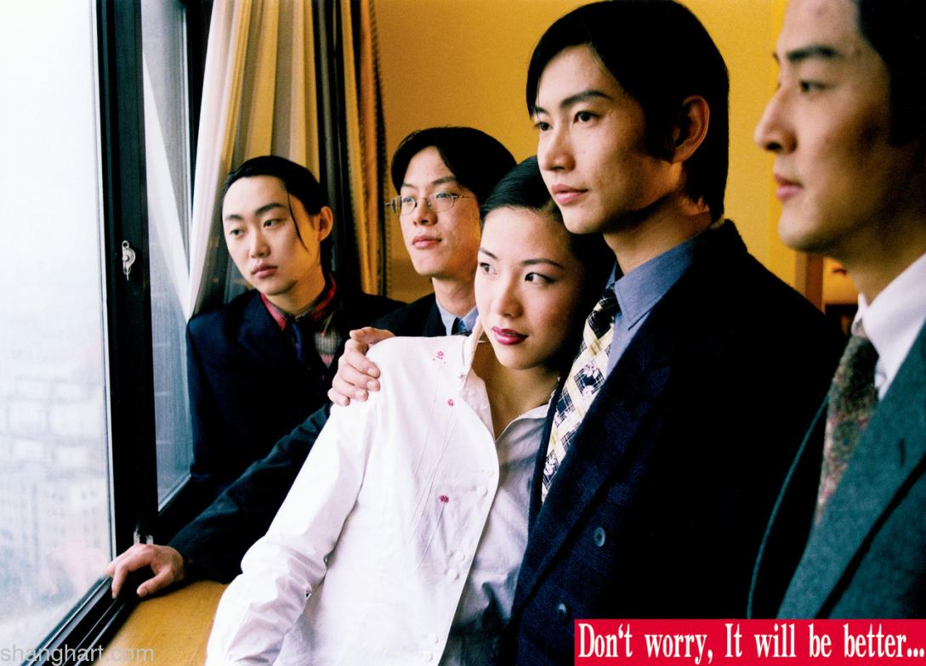
Yang Fudong, Don’t worry, It will be better, 2000

Slide 34
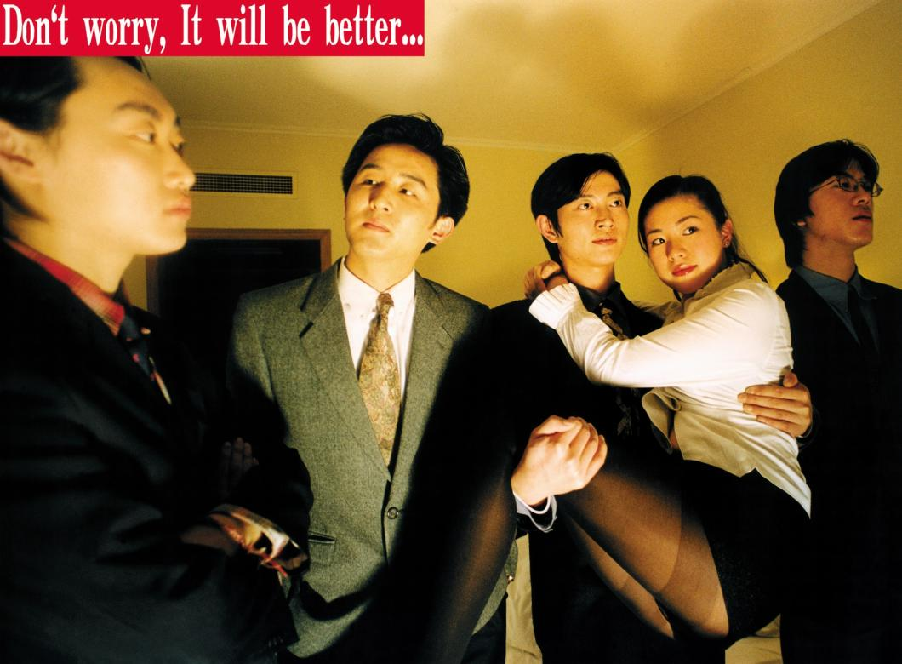
Yang Fudong, Don’t worry, It will be better, 2000

Slide 35
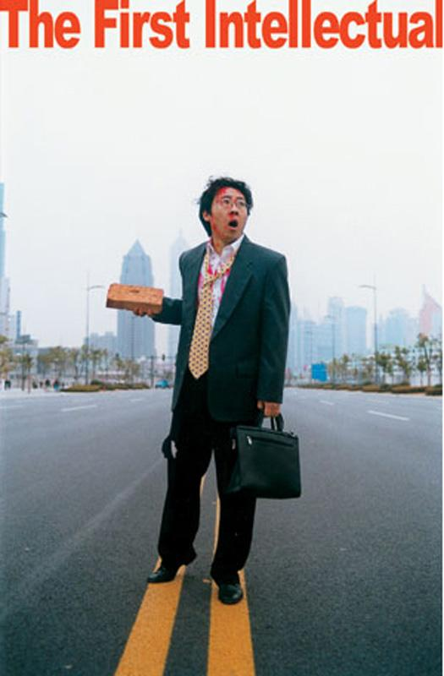
Yang Fudong,
The First Intellectual,
2000

Slide 36
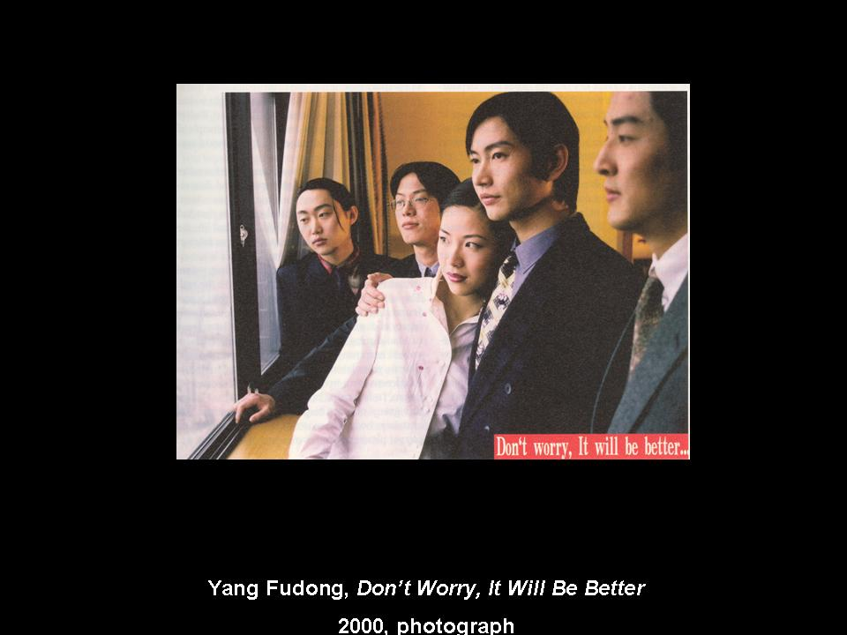
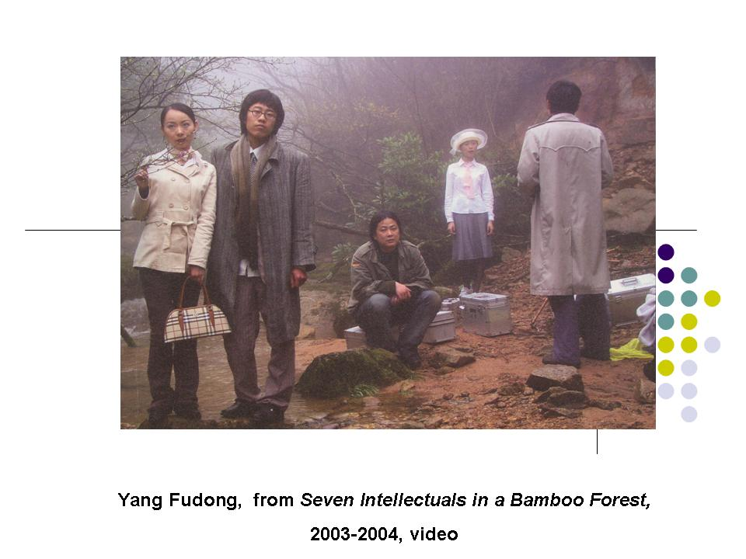

Slide 37
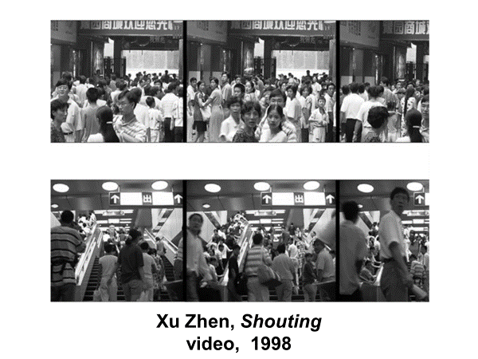

Slide 38
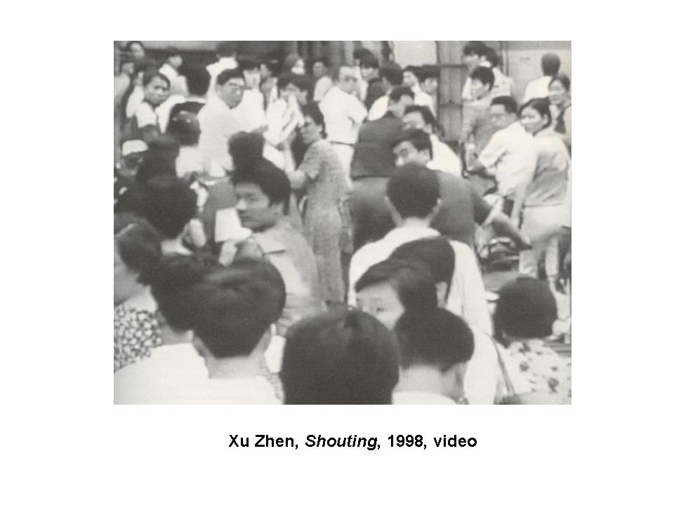

Slide 39
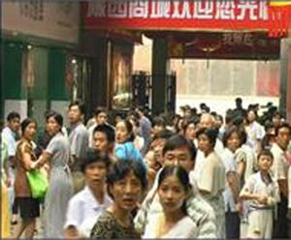

Slide 40
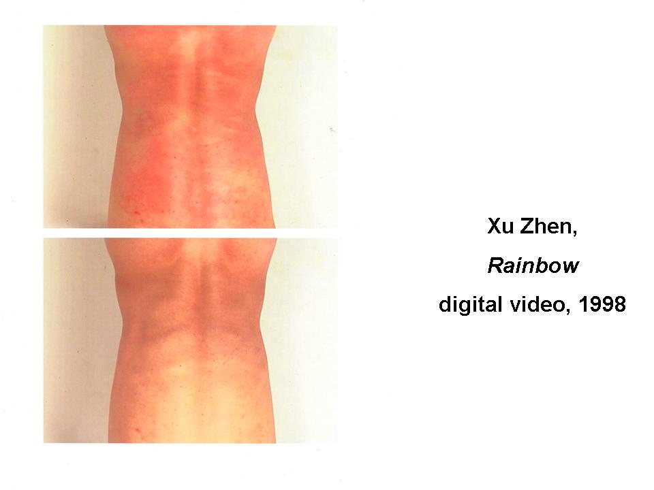

Slide 41
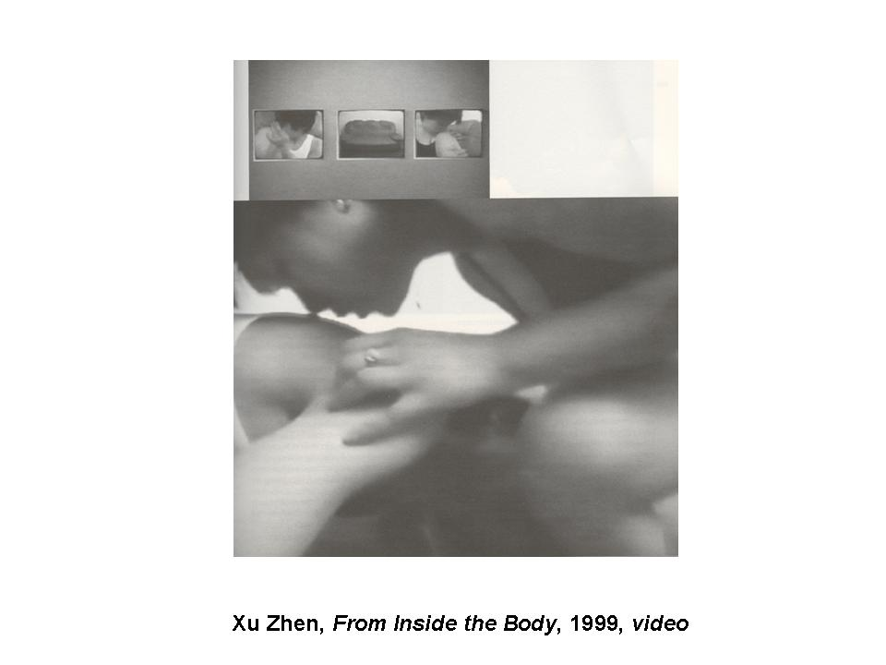

Slide 42
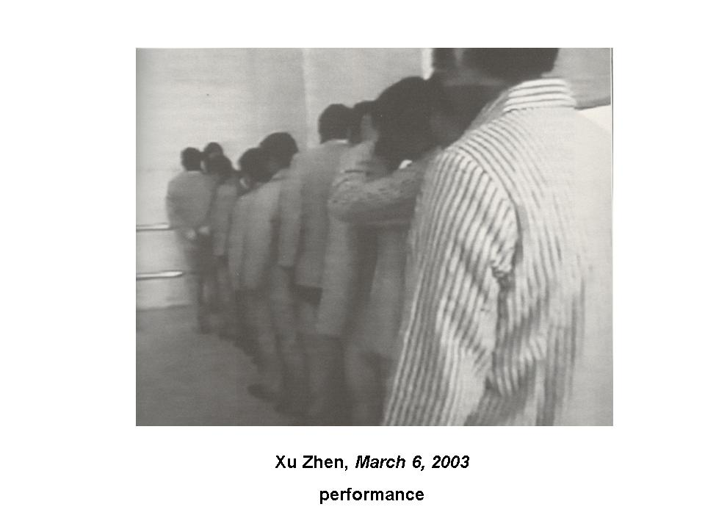

Slide 43


Slide 44


